Slide 1
ALGORITHMS WARM-UP COMPETITION (BONUS)
COLOR-BASED IMAGE SIMILARITY

Slide 2
Agenda
Problem Definition
Technical Definitions
Digital Image
Histogram
Cosine Distance
Given Code
Required Functions
Testing
Competition Rules

Slide 3
WARM-UP COMPETITION – BONUS
Color-Based Image Similarity:
Given: a query image and a set of target images
Req.: Find the most similar image(s) based on color histgrams?
Apps:
Image retrieval
Visual search in e-commerce
Clustering/Categorization
Detect duplicates

Slide 4
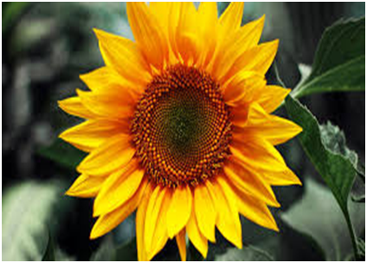
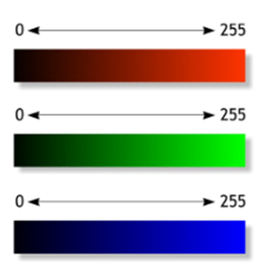
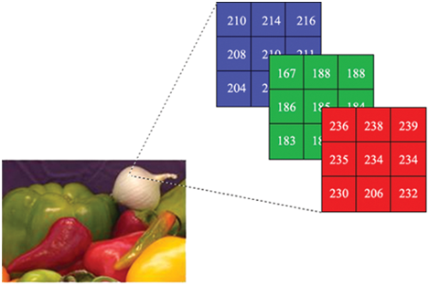
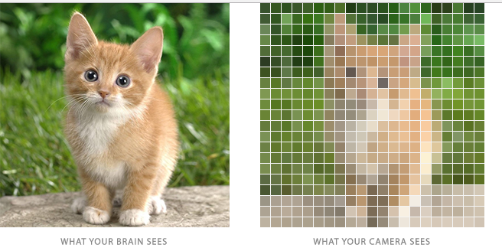
WARM-UP COMPETITION – BONUS
Color-Based Image Similarity:
Definitions:
Digital Image:
2D array of picture elements called pixels,
Each pixel has its own intensity value,
True Color images have intensity from the darkest (0) to lightest (255) of three different color channels: Red, Green, and Blue.

Slide 5
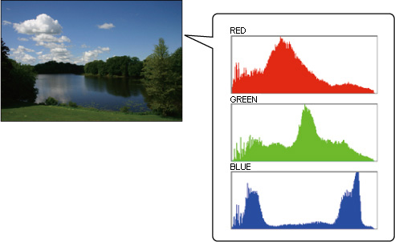
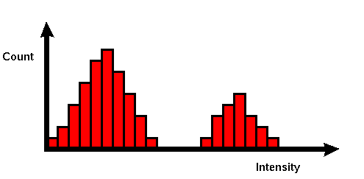
WARM-UP COMPETITION – BONUS
Color-Based Image Similarity:
Definitions:
Histogram:
A graph showing the number of pixels (i.e. frequencies) in an image at each different intensity value found in that image.
There’s a different histogram for each channel (Red, Green, and Blue).
There are 256 possible values on x-axis.
0 255

Slide 6
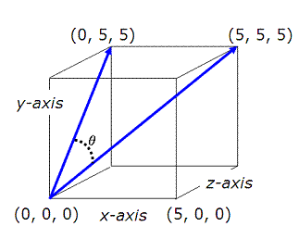
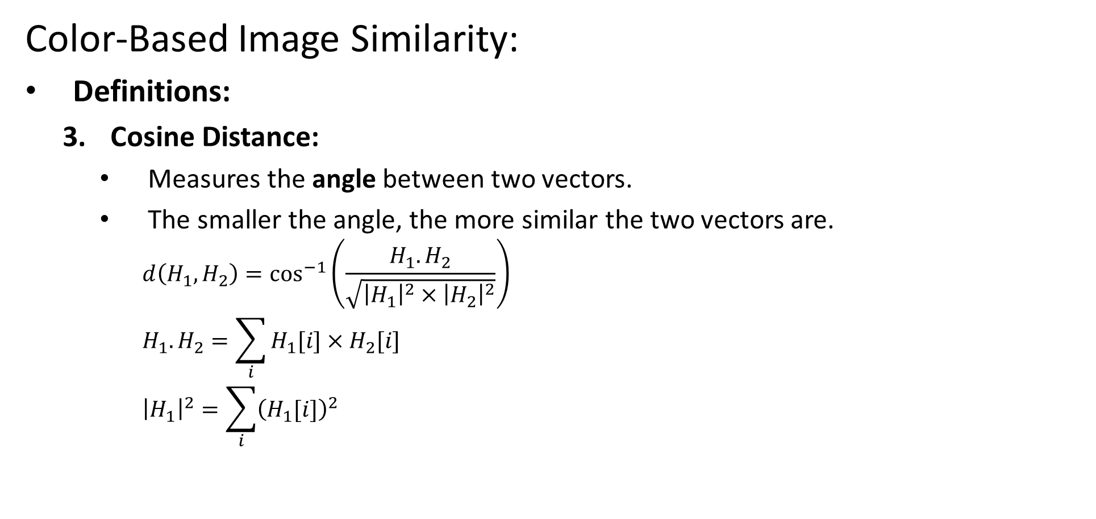
WARM-UP COMPETITION – BONUS
Color-Based Image Similarity:
Definitions:
Cosine Distance:
Measures the angle between two vectors.
The smaller the angle, the more similar the two vectors are.
$$d\left(H_{1},H_{2}\right)=\cos^{−1}\left(\frac{H_{1}.H_{2}}{\sqrt{{\left|H_{1}\right|}^{2}×{\left|H_{2}\right|}^{2}}}\right)$$
$$H_{1}.H_{2}=\sum_{i}{H_{1}[i]×H_{2}[i]}$$
$${\left|H_{1}\right|}^{2}=\sum_{i}{{\left(H_{1}[i]\right)}^{2}}$$
0◦: identical, 90◦: totally different

Slide 7



WARM-UP COMPETITION – BONUS
Color-Based Image Similarity:
Definitions:
Cosine Distance:
For image similarity:
Consider the histogram of each color as a separate vector in 256-D space
Convert it to a probability distribution by dividing each value over the image size (W × H)
Calculate the distance between each color vector, then average them.
R
5
20
…
66
32
G
64
21
…
23
92
B
12
44
…
5
9
R
0.001
0.05
…
0.2
0.1
G
0.21
0.087
…
0.099
0.34
B
0.014
0.12
…
0.007
0.009
$$d\left(R_{1},R_{2}\right)$$
3
$$d\left(G_{1},G_{2}\right)$$
+
/
$$d\left(B_{1},B_{2}\right)$$
ClrDist

Slide 8
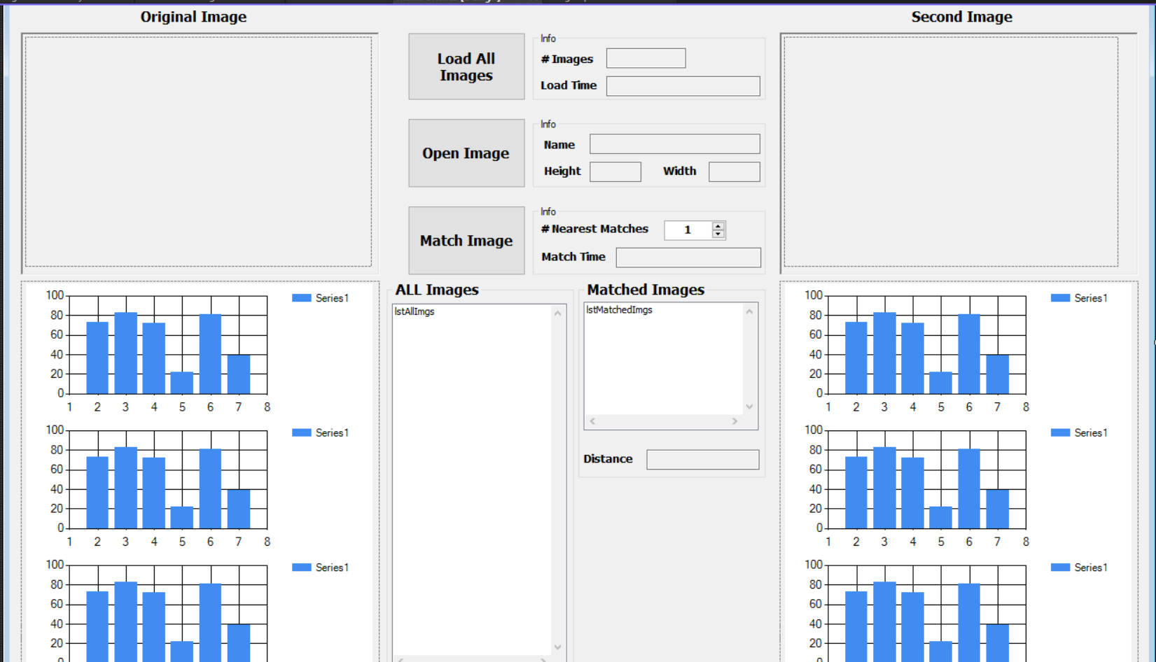
WARM-UP COMPETITION – BONUS
Color-Based Image Similarity:
Given: C# Template
Working GUI
Load ALL target images from the browsed folder and calculate their statistics
K
Load the query image from the browsed location and calculate their statistics
Match the query image with the target images and return the TOP K matches

Slide 9
WARM-UP COMPETITION – BONUS
Color-Based Image Similarity:
Given: C# Template
Image Helpers
ImageOperations class with the following functionalities:
Open image & load it in a 2D array (Height × Width) of type RGBPixel[,]
RGBPixel[,] OpenImage(string ImagePath)
Get width and height of the image matrix
int GetHeight(RGBPixel[,] ImageMatrix)
int GetWidth(RGBPixel[,] ImageMatrix)
Display an image on a given PictureBox control
void DisplayImage(RGBPixel[,] ImageMatrix,PictureBox PicBox)
RGBPixel is a structure defined in the code to hold the Red, Green & Blue of each pixel

Slide 10
WARM-UP COMPETITION – BONUS
Color-Based Image Similarity:
Required: 3 functions inside ImageHistSimilarity.cs
Calculate Image Statistics
ImageInfo CalculateImageStats(string imgPath)
Load the image from the given path
Calculate the following statistics for each color and store it in struct ChannelStats
Minimum value
Maximum value
Median value
Mean
Standard deviation
Histogram
Fill-up the info in struct ImageInfo and return it
public struct ImageInfo
{
public string Path;
public int Width;
public int Height;
public ChannelStats RedStats;
public ChannelStats GreenStats;
public ChannelStats BlueStats;
}

Slide 11
WARM-UP COMPETITION – BONUS
Color-Based Image Similarity:
Required: 3 functions inside ImageHistSimilarity.cs
Load ALL Images
ImageInfo[] LoadAllImages(string []targetPaths)
Load ALL target images
Calculate their statistics and return them

Slide 12
WARM-UP COMPETITION – BONUS
Color-Based Image Similarity:
Required: 3 functions inside ImageHistSimilarity.cs
Match Query with Target
MatchInfo[] FindTopMatches(string queryPath, ImageInfo[] targetImgStats, int numOfTopMatches)
Open the query image and calculate its statistics (queryPath)
Calculate the cosine distance between it and all target images (targetImgStats)
Return TOP matches (numOfTopMatches)
public struct MatchInfo
{
public string MatchedImgPath;
public double MatchScore;
}

Slide 13
WARM-UP COMPETITION – BONUS
Color-Based Image Similarity:
Testing:
Sample Test:
Goal: test the correctness
Given:
Ten small target images with the expected stats ➔ will be automatically checked
Four small query image with expected scores ➔ will be automatically checked
Complete Test:
Goal: test the efficiency (beside correctness)
Given:
Set of variable-size target images with the expected stats ➔ will be automatically checked
Set of query images

Slide 14
WARM-UP COMPETITION – BONUS
Color-Based Image Similarity:
Competition Rules:
Criteria:
Correct O/P
Execution time
Delivery:
DUE TO: THU 20 FEB 23:59
Submit ENTIRE content of “ImageHistSimilarity.cs” at this form
Bonuses:
TOP 50
TOP 5

Slide 15


